Slide 1
Leveraging Large Language Models (LLM) for AIS Vessel Trajectory Prediction
CSCI 6917 - Guided Research Grad I
Ryan Gross (G47667332)
Summer Semester - 2023

Slide 2
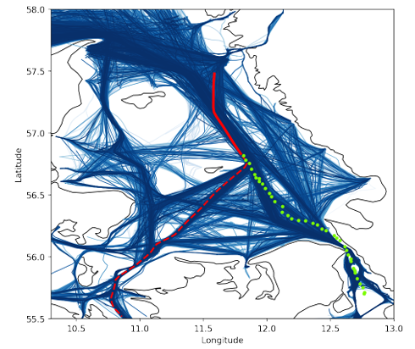
Project Objective
What are you trying to do? Articulate your objectives using absolutely no jargon.
Predict the future trajectory of cargo vessels.
How is it done today, and what are the limits of current practice?
Various seq2seq approaches such as RNN, LSTM, and transformers are used, but implementation is complex.
What is new in your approach and why do you think it will be successful?
The approach treats the problem as a language translation task, which LMMs are good at, allowing pre-trained LLMs to solve the problem with little effort and complexity from the software engineer.
Who cares? If you are successful, what difference will it make?
EMS, Coast Guard, Navy, and other maritime forces could better locate distressed or malign vessels.
What are the risks?
LLM may not properly format messages, LMM may not pick up on vessel patterns.
How much will it cost? How long will it take?
$12 and a summer semester.
What are the mid-term and final “exams” to check for success?
Mid-term: Ensure LLM can issue predictions with the correct data format
Final: Performance beats or is near state-of-the-art
2

Slide 3
Technical Approach - Architecture
Prediction Visualization
Fine-Tuned Model
Fine-Tuning
File Generator
Test Runner
Dutch AIS Dataset
Open AI GPT Services
Performance Evaluator
Project Contributions
Other data, software, and services
3

Slide 4
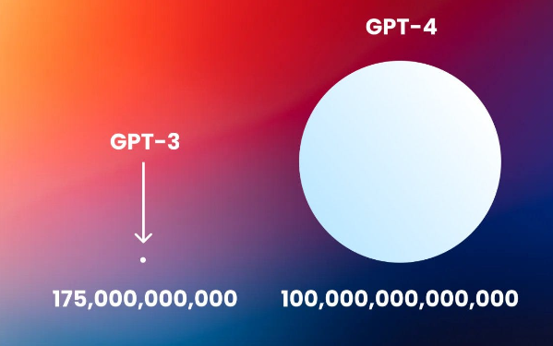
Technical Approach – Key Steps
Find and gather dataset – Needed to be free and large.
Clean data – Remove paths over land, non-moving vessels, impossibly fast trips, etc
Find best base model – Run Few-Shot learning on each model to determine best model to fine-tune
Format data using prompt engineering
Evaluate
Visualize
Compare
Create trained model – Create custom model by fine-tuning best base model
Format data in GPT required JSONL for training
Ensure time and cost of training meets requirements/limits
Run fine-tuning job
Evaluate trained model – Run test set and measure accuracy loss
Visualize – Plotting
Individual predictions to better understand results
Overall accuracy loss across test set
Parameters
Parameters
4

Slide 5
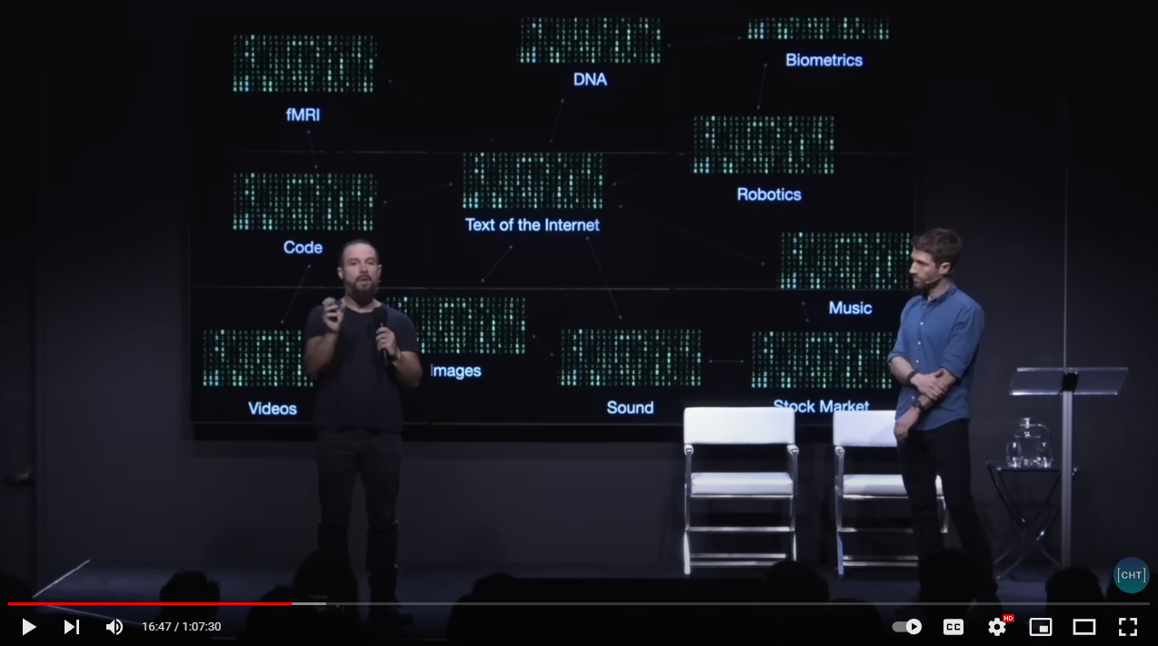
Technical Approach – Innovation
This research further investigates the intuition that a large portion of prediction problems can be thought of as seq2seq, generative language problems.
Examples:
Text phrase -> Python code (Code generation)
Text phrase -> Image (Image generation)
Image -> Next image (Image sequence generation)
English phrase -> French phrase (Speech translation)
Research paper text -> Research paper abstract (Text summarization)
Stock market historical data -> Stock market buy & sell tasks
Python code -> Code comments and documentation
Historical GPS locations -> Future GPS locations (This project)
Leveraging existing, expertly trained models, could reduce the cost and complexity of solving many prediction problems.
“Treat everything as language”
https://youtu.be/xoVJKj8lcNQ?t=967
5

Slide 6
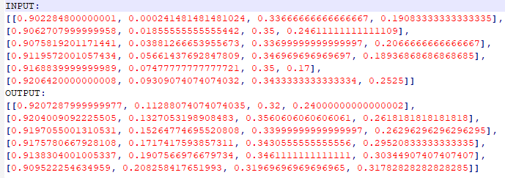
Technical Approach – Innovation Cont.
LLM
(Transformer)
The dataset is prepared to contain four input fields:
Latitude
Longitude
Speed over Ground (SOG)
Course over Ground (COG)
The first half of a vessel trip is the input to the model, and the second half of the trip is the output the model should predict.
After enough input output pairs, the LLM learns to complete the vessel’s trip only given the input. This is similar to text completion in email or texts.
Why LLMs instead of just using a transformer?
Training a transformer from scratch requires learning both data format and data content patterns.
LLMs are already trained to detect text format patterns. This is why “fine-tuning” LLMs has become popular.
LAT
LON
SOG
COG
LAT
LON
SOG
COG
Input Sequence
Output Sequence
6

Slide 7
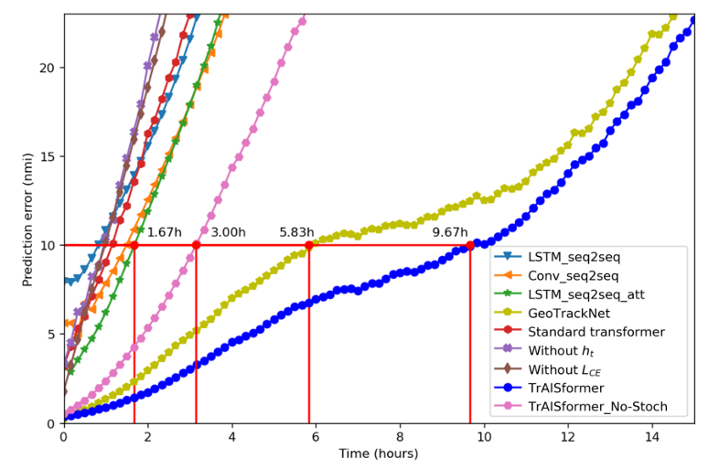
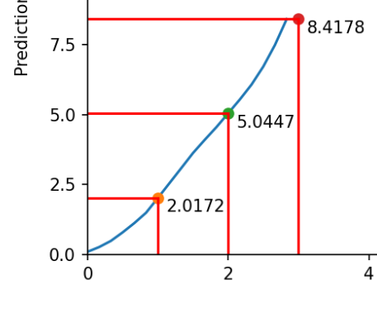
Results – Few Shot
Error rates of vessel location predictions 3 hours into the future:
Most solutions: 20+nmi
State-of-the-Art: 3nmi
GPT 3.5 Turbo: 8.4nmi
GPT 3.5 Turbo was the best performing model used in the project.
State-of-the-art Solution
Best Results from Project
(GPT 3.5 Turbo, Few Shot)
7

Slide 8
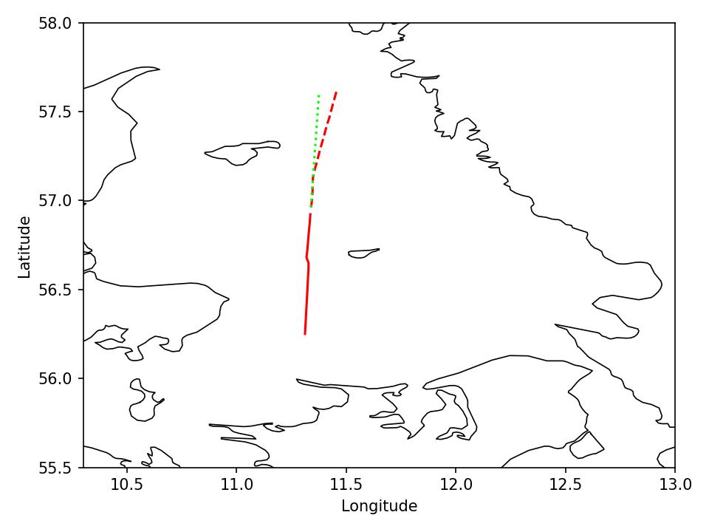
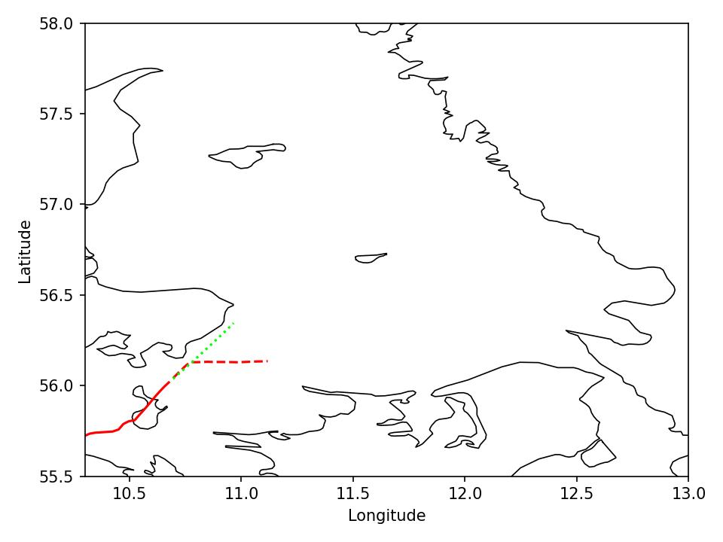
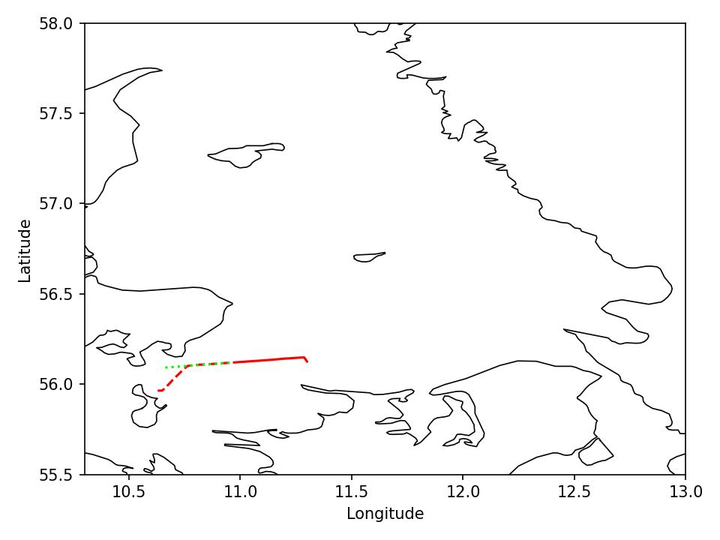
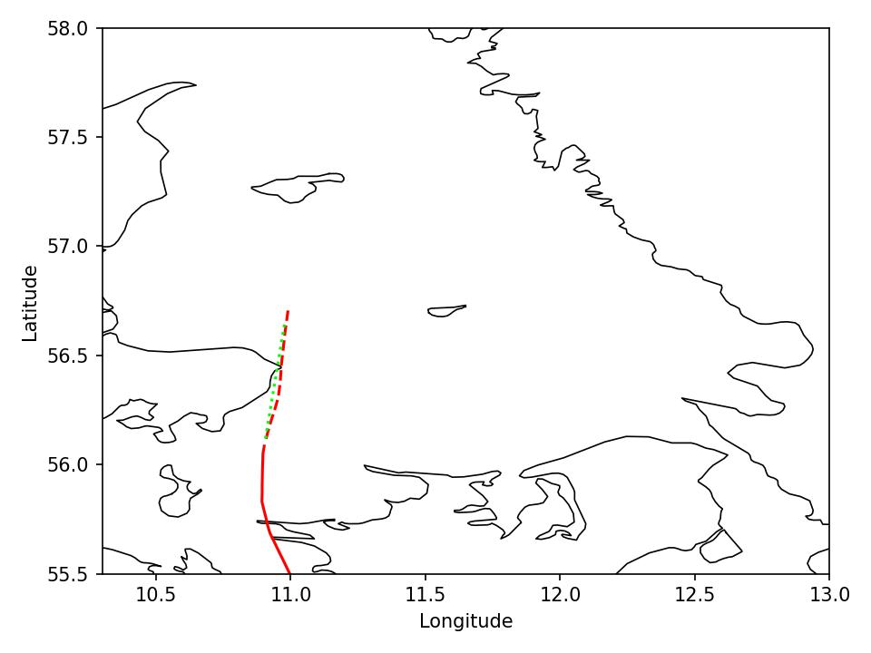
Results – Few Shot
GPT 3.5 Turbo appears to draw a strait line from the input.
This is about as well as a human would do without any prior knowledge of shipping lanes.
8

Slide 9
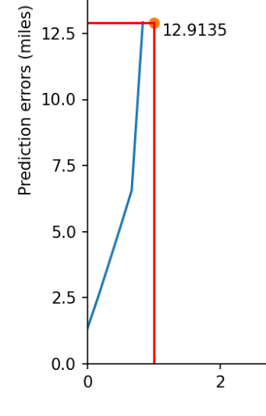
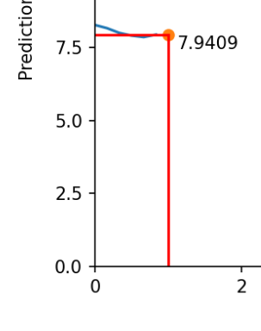
Results – Fine Tuning
GPT 3.0 is the only family of models that can be fined tuned in the Open AI suite of models.
GPT 3.0 only supports enough input and output tokens to predict 1 hour into the future.
Fine-tuning clearly improved the model’s performance, nearly doubling accuracy.
When GPT 3.5 fine-tuning becomes available, the overall solution would likely perform closer to the state-of-the-art results.
GPT 3.0
Davinci
Few Shot
GPT 3.0
Davinci
Fine-Tuned
9

Slide 10
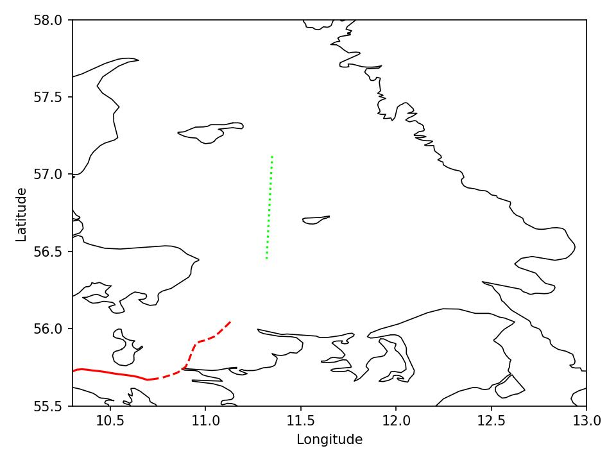
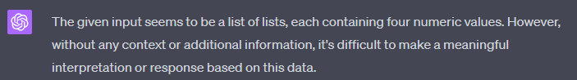

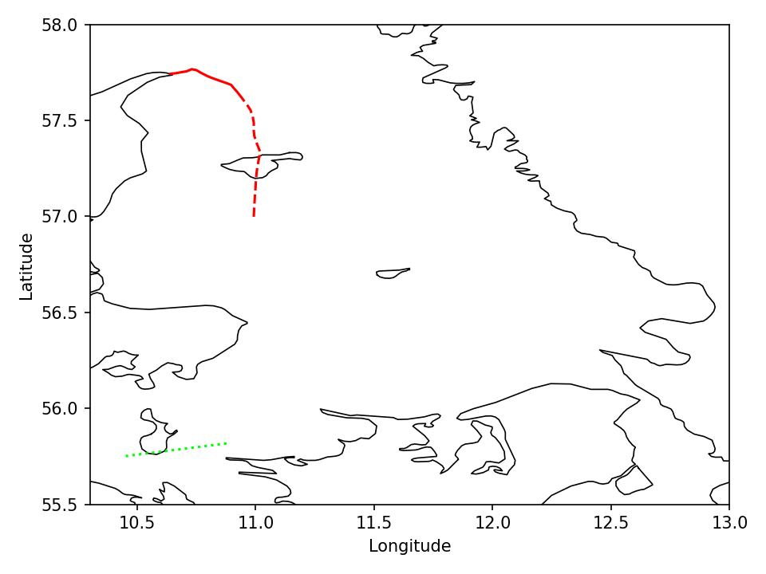

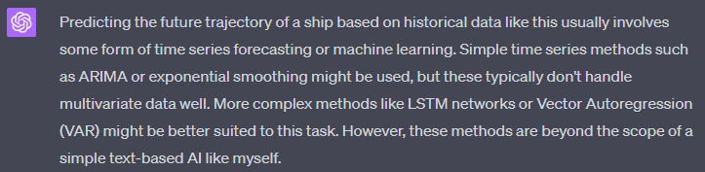
Results – GPT 4.0
GPT 4.0 asked for clarification, said it was not well suited to answer the question, and when it finally obliged, provided very poor answers.
10

Slide 11
Conclusion
GPT 3.5 Turbo
With very few lines of code and “few-shot” training, GPT 3.5 Turbo outperforms many non-transformer algorithms.
GPT 3.5 Turbo seemed to perform about as well as a human, drawing a strait line from the end of the input.
GPT 3.5 Turbo picked up on LAT and LON patterns but did not pick up on SOG & COG patterns.
Fine-tuning not available
GPT 3.0
Accepts too few characters as input and output to effectively pick up on patterns.
Training is expensive. Original 26.3MB training file had to be reduced to 177KB to stay under $10 billing limit.
GPT 4.0
Strangely, performed about as well as GPT 3.0.
Fine-tuning not available
While the original intuition and approach remains valid, OpenAI’s services allow for very limited customization or fine-tuning. Additionally, the cost to fine-tune is prohibitive to research students.
GPT 3.5 Turbo few-shot prediction in green, actual is dashed red, input is solid red.
11

Slide 12
Future Work
Graduate Thesis Level
Continue to work with GPT 4.0 prompt engineering to try to increase performance.
Train an array of open source LLMs to compare results to state-of-the-art.
Compare LLMs with transformers trained from scratch.
Try different combinations of input and output features.
PhD Dissertation Level
Understand how the transformer is learning trajectory patterns.
Understand how to optimize transformer/LLM parameters for trajectory prediction (heads, layers, embedded layers, learning rate, warm up tokens).
Build and demonstrate a transformer/LLM model that is state-of-the-art in location prediction.
Demonstrate applicability and versatility of model on ground, maritime, and air domains, given domain specific features.
12

Slide 13
References
[1] Vaswani, Ashish et al. “Attention is All you Need.” NIPS (2017).
[2] Nguyen, Duong and Ronan Fablet. “TrAISformer-A generative transformer for AIS trajectory prediction.” ArXiv abs/2109.03958 (2021): n. pag..
[3] D. Nguyen, R. Vadaine, G. Hajduch, R. Garello, and R. Fablet, “A Multi-task Deep Learning Architecture for Maritime Surveillance using AIS Data Streams,” in 2018 IEEE International Conference on Data Science and Advanced Analytics (DSAA), Oct. 2018.
[3] D. Nguyen, R. Vadaine, G. Hajduch, R. Garello, and R. Fablet, “GeoTrackNet-A Maritime Anomaly Detector using Probabilistic Neural Network Representation of AIS Tracks and A Contrario Detection,” IEEE Transactions on Intelligent Transportation Systems, Feb. 2021.
[5] Ouyang, Long et al. “Training language models to follow instructions with human feedback.” ArXiv abs/2203.02155 (2022): n. Pag.
[6] Brown, Tom B. et al. “Language Models are Few-Shot Learners.” ArXiv abs/2005.14165 (2020): n. Pag.
13

